Slide 1

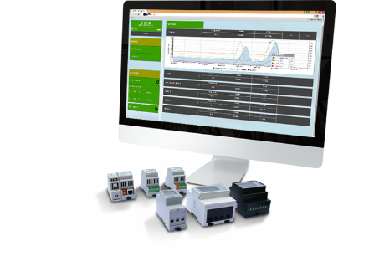
Energy Monitor webserver based
By: QONNEX

Slide 2


Slide 3
Questions about energy consumption, are easily answered with 2-Wire;
How do you collect the shared energy costs among tenants?
What does my heat pump, gas heater or ventilation system cost? Yesterday? Last month?
Can I also monitor my water consumption?
Can you measure a calculated EPC number?
What did the extra isolation provide in my last renovation project?
Which household appliance can I replace better soon?
How much solar energy do I stop in the grid?
How do I get my monthly energy bill down?
Can I compare the energy efficiency of my home with other homes?
...

Slide 4
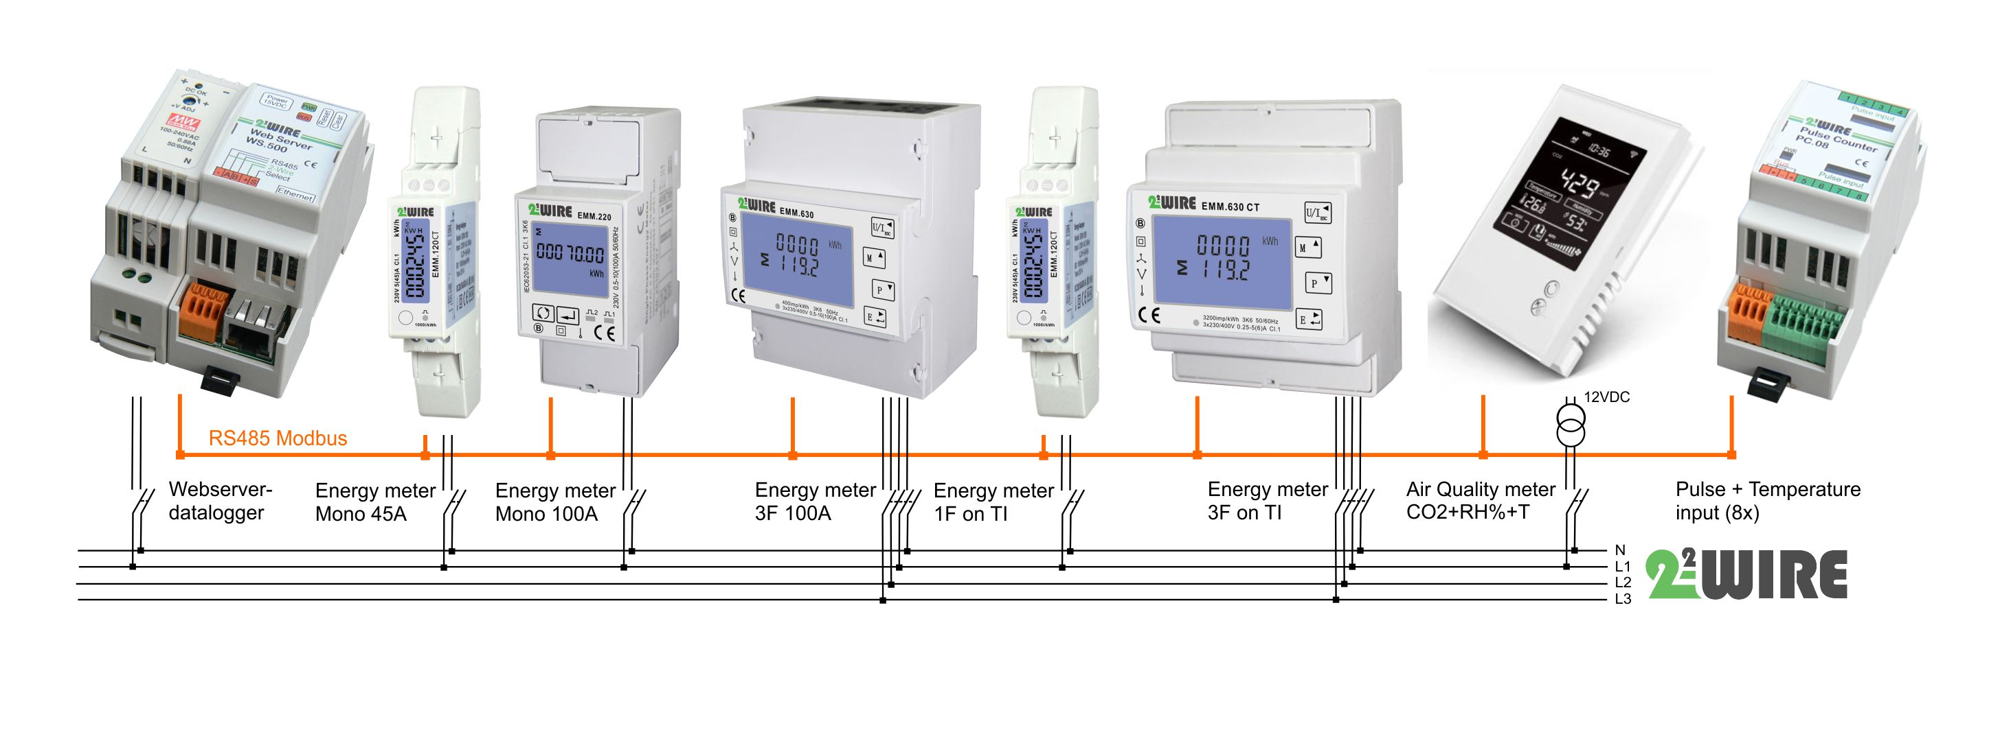
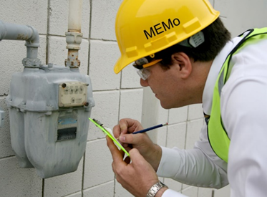
2.Product: B2B :“MEMo” energy datalogger-webserver
RS485 MODbus
Max 64 log channels :
Consumption values: Electric, gas, water, fuel, water energy,…
Energy values: air quality, temperature, electric values,..
Advanced wired Energy meters
Master-slave
Data resolution: 1 minute readings
1000 meter, topology: line

Slide 5
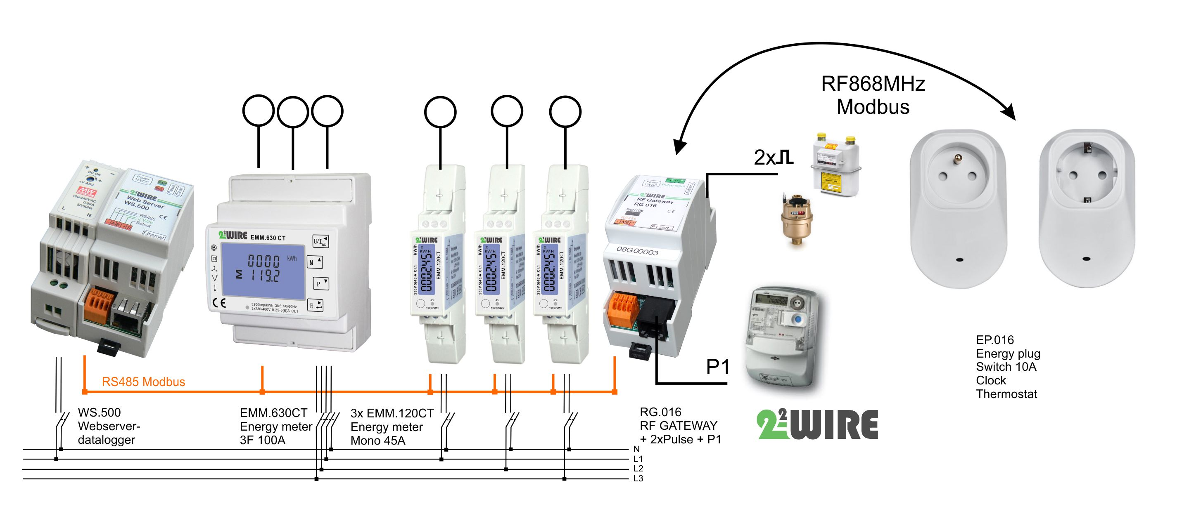
NEW:RG.016: RS485 modbus to RF gateway (Q4/2017)

Slide 6
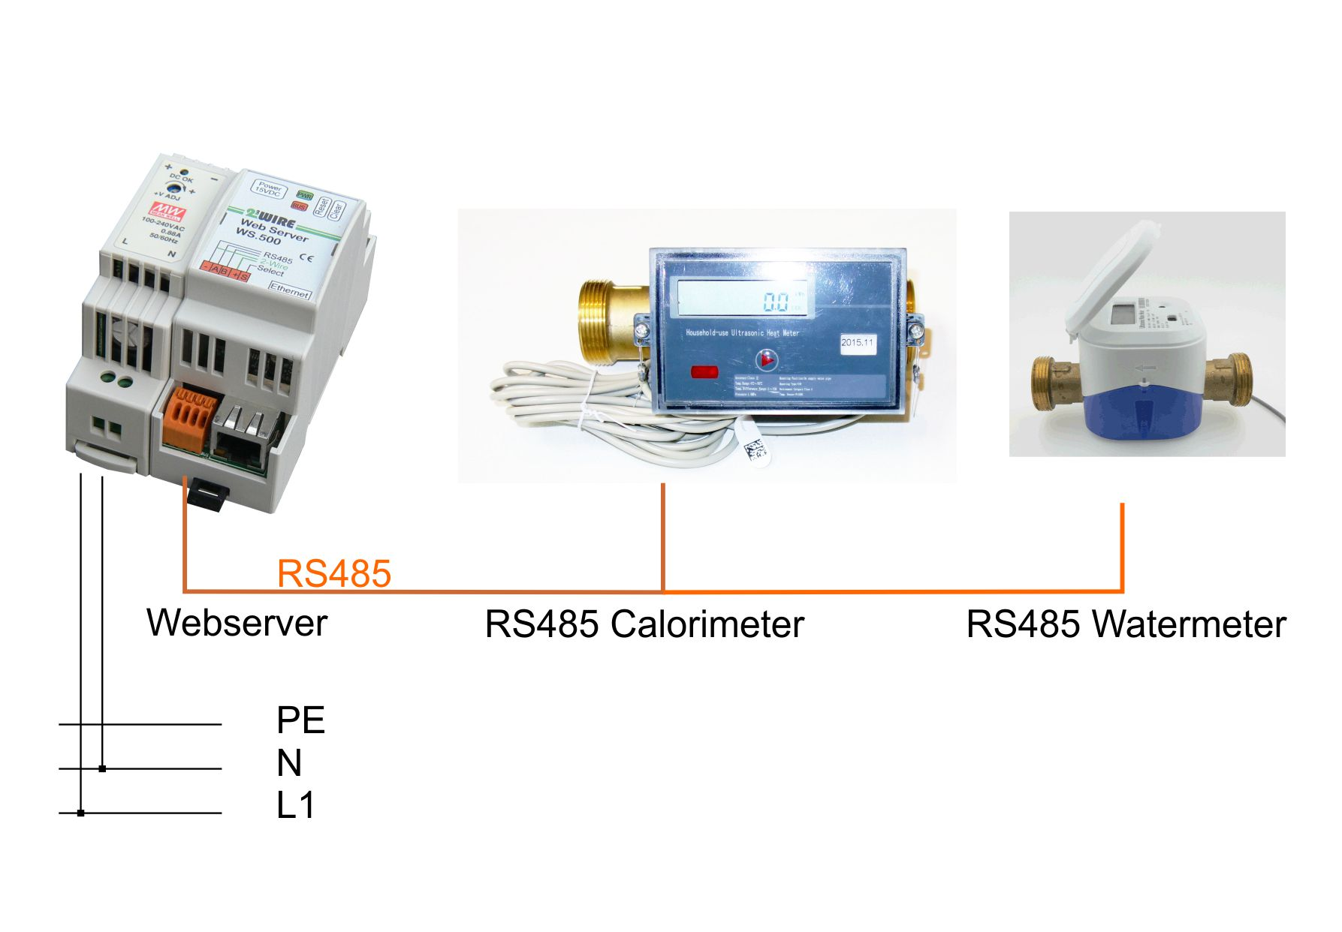
NEW: RS485 calorimeter and watermeter (Q4/2017)
Direct connection to RS485 calorimeter (DN15,20,25,32,40) and watermeter (DN15,20,25)
Up to 64 meter with meter reading every 60’

Slide 7

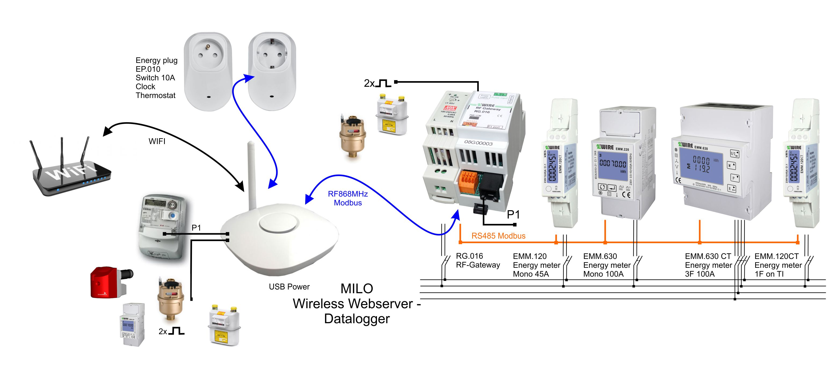
3. B2C “MiLo” home energy control
WiFi + RF868 MHz MODbus
Max 16 energy channels
Wireless Energy plugs
Master-slave
Data resolution: 1 hour readings
30m indoor/300m outdoor/ 3 walls

Slide 8
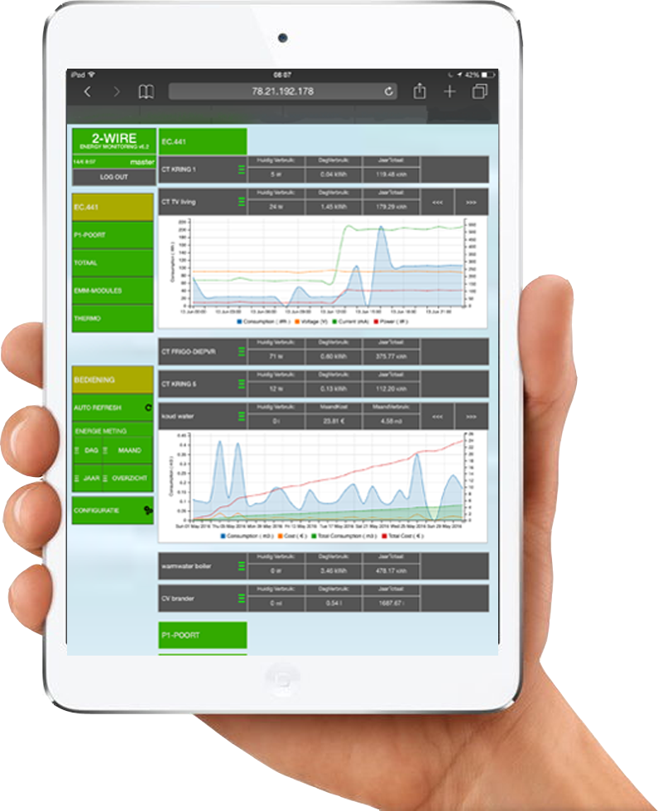
4.Functionalities
Visualisation on local webserver
  No software, any tablet or PC, local data storage
End-user Functionalities:
  Real-Time + historical energy consumption
  High resolution for diagnostic reason
  Real-time EPC value
  Control outlets
  Overview Energy costs
  Calculating subtotals (only MEMo)
  Email notification (only MEMo)
  Upload data to remote server
  Http request instructions to retrieve data(only MEMo)

Slide 9
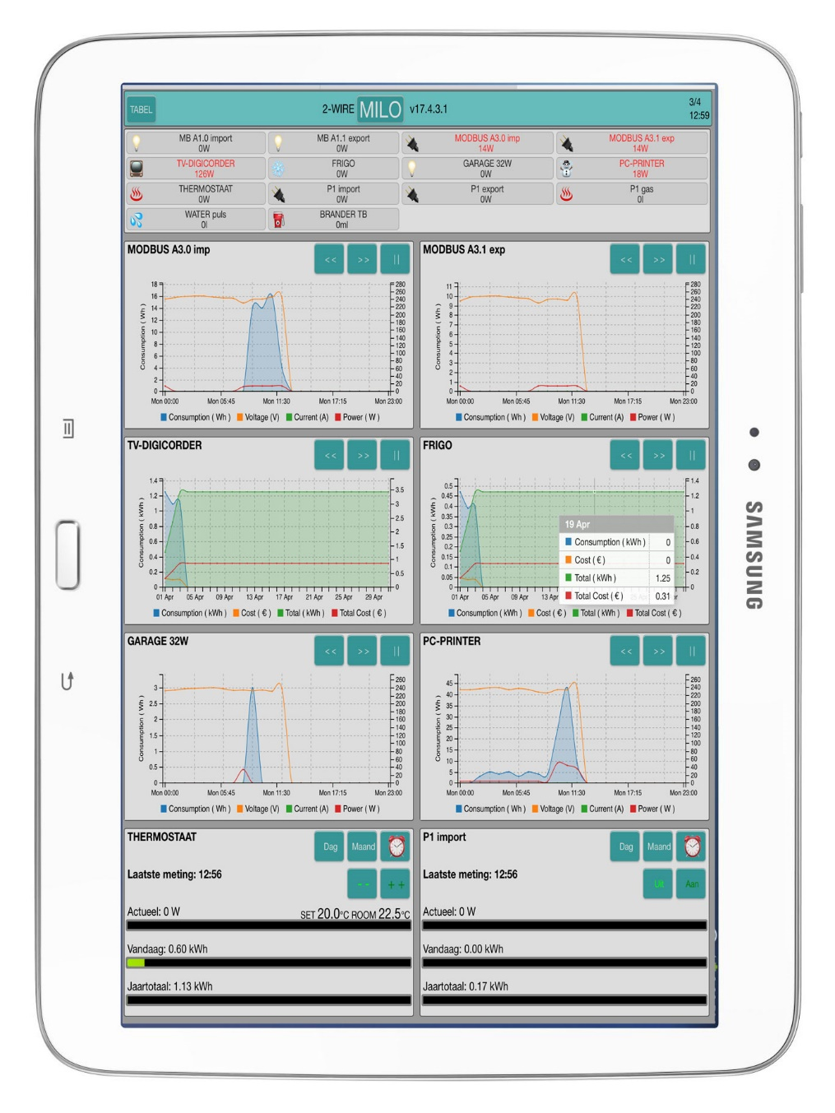
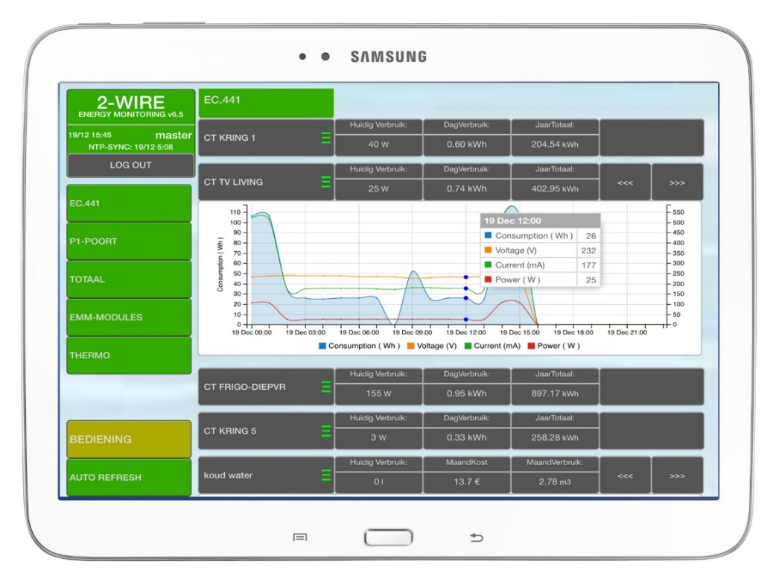
A. Real-Time + historical energy consumption
MiLo
Real-time
1 day: 24 hrs
1 month: 30 days
1 year : 12 months
 | MEMo | MiLo
Logchannels | 64 | 16
Resolution | 60 seconds | 60 minutes
Local data storage max. | 3 years, raw data | 1 year
Data local accesible for app's | Yes | No
Simultanious users | 5 | 1
FTP data upload | Yes | Yes, fixe format + fixe remote server
FTP Firmware update | Yes | Yes
SUBtotals | Yes | No
EPC calculations | Yes | No
MEMo

Slide 10
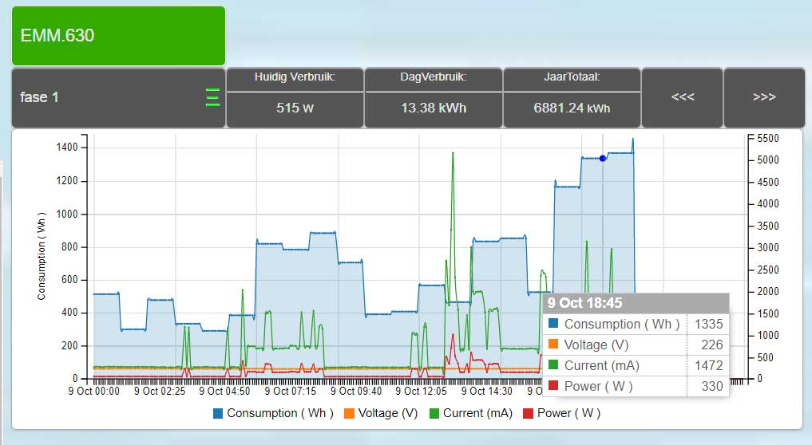
B. High resolution for diagnostic reason (MEMo only)
Webserver:
60 seconds resolution during last 12 day’s: power, current, voltage
FTP client & http request:
Export 60 seconds resolution csv format or JSON format from last 36 months data: meter readings, power, current, voltage, power factor

Slide 11
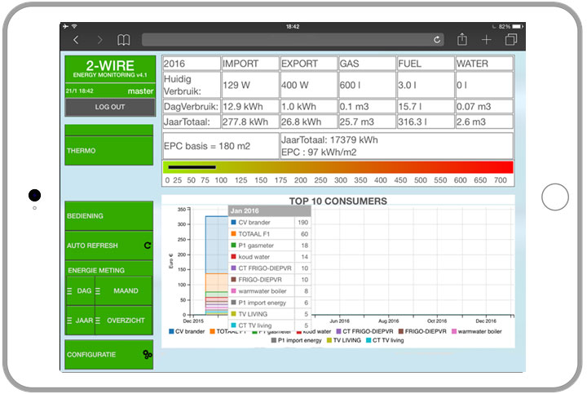
C. Real-time EPC value (MEMo only)
Items:
Totals: Elec-Solar-Gas Water
Measured real-time EPC value
TOP 10 consumers
TOP 10 consumers in detail

Slide 12
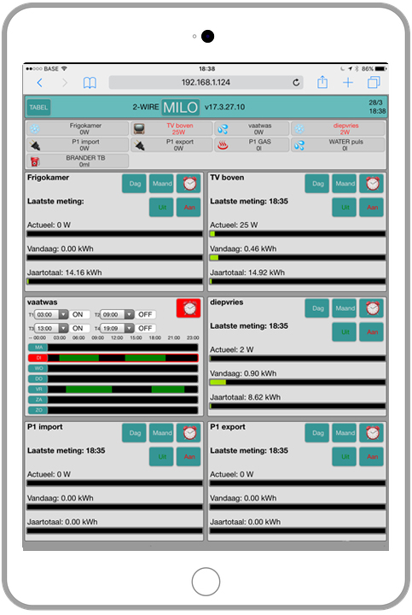
D. Control outlets (MiLo&MEMo)
On/Off:
Manual by remote
Scheduled in time
Automatic by temperature
Logical through consumption

Slide 13
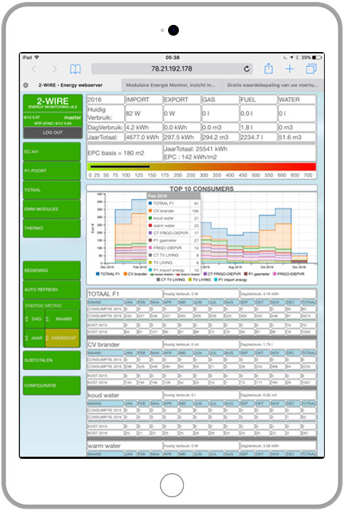
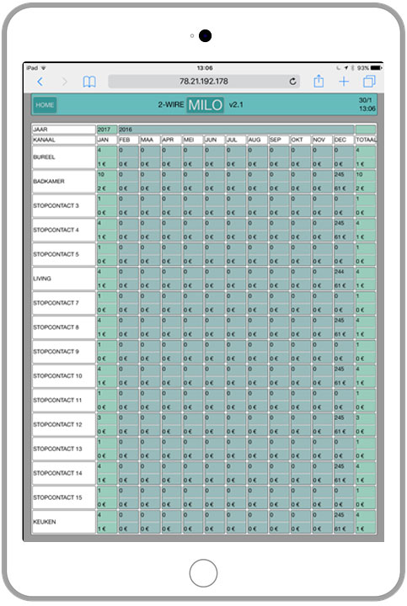
E. Overview Energy costs
MEMo MiLo
Overview per month
  Energy consumtion
  Energy costs

Slide 14
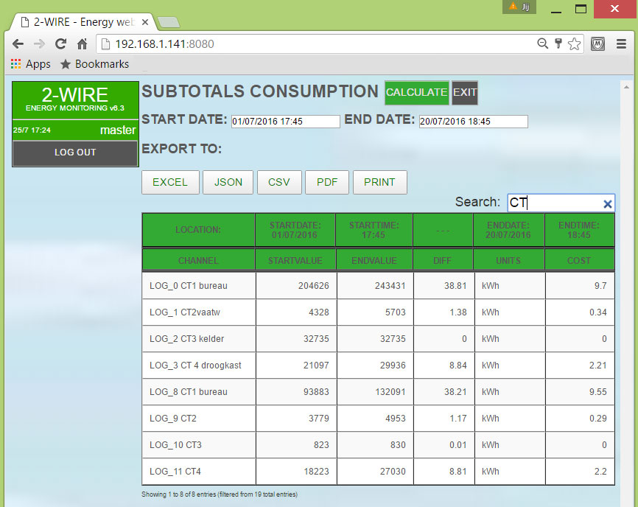
F. Calculating subtotals (MEMo only)
An easy solution for Energy billing:
  All meter-values are stored 3 years
  Webserver calculates sub-meter consumptions in a given time period
  Filter option to find the right meters
  Export the result to: Excel, JSON, CSV, PDF, print format

Slide 15
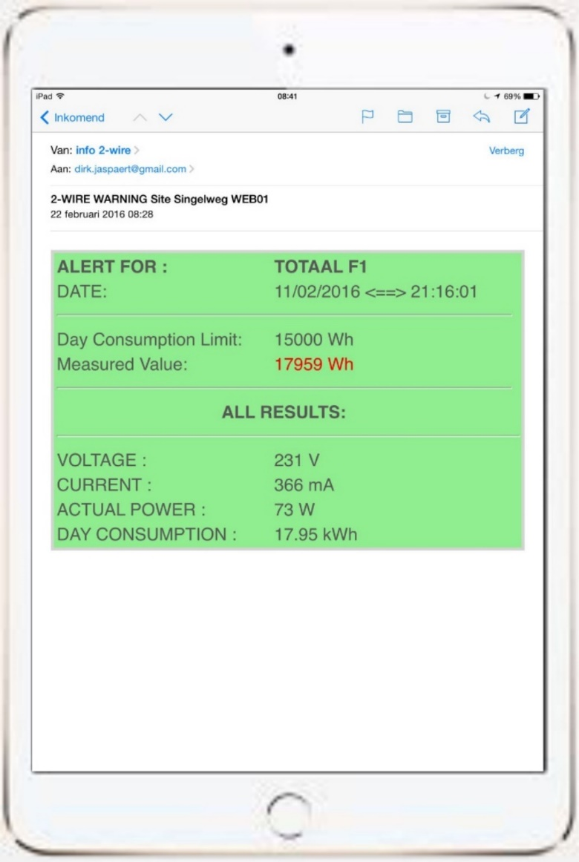
G. Email notification (MEMo only)
Email alert on each of the 64 consumers:
Maximum power
Maximum day consumtion
Lower or higher temperature
Error input signal

Slide 16
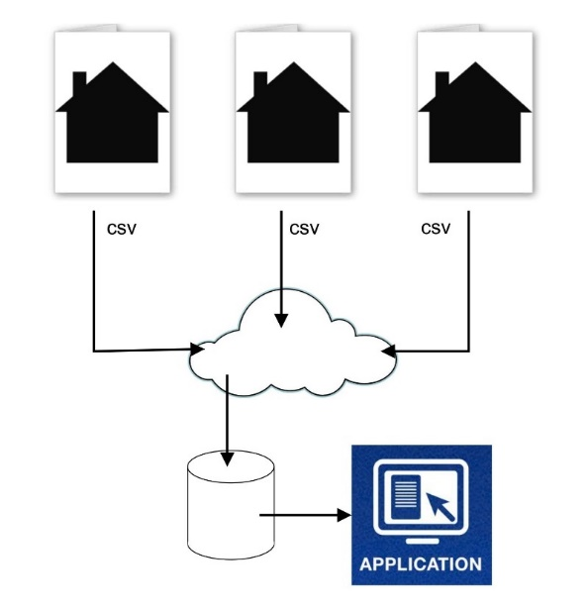
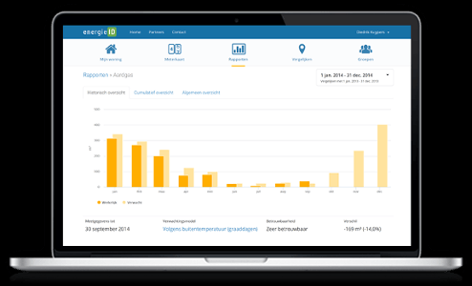
H. FTP upload data to remote server (MEMo only)
Using webserver as FTP client to upload data to remote server
Compare your consumption with other home’s or buildings:
  EnergieID: residential&public cloud application

Slide 17
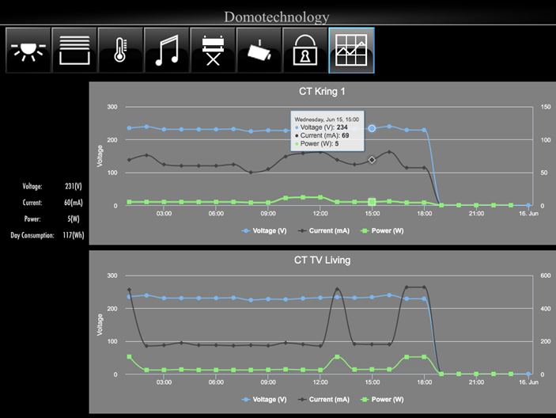
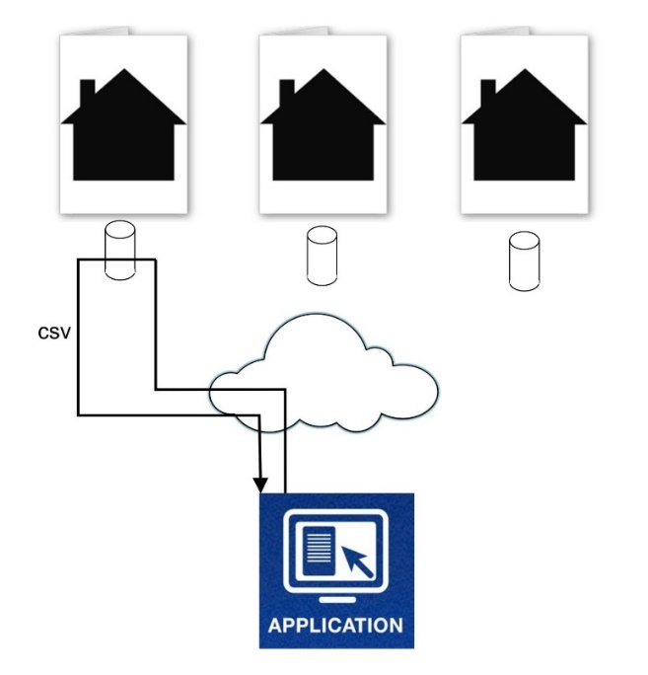
I. http request instructions to retreive data in JSN format (MEMo only)
DIRECT LINK METERVALEU’S:
http://78.21.192.178:8080/demo2WIRE_NL?XP1234&XP&8=GetLogHour&16&180&30&10&
DIRECT LINK MEASURED VALEU’S:
http://78.21.192.178:8080/demo2WIRE_NL?XP1234&XP&8=GetLogRT&16&180&30&10&

Slide 18
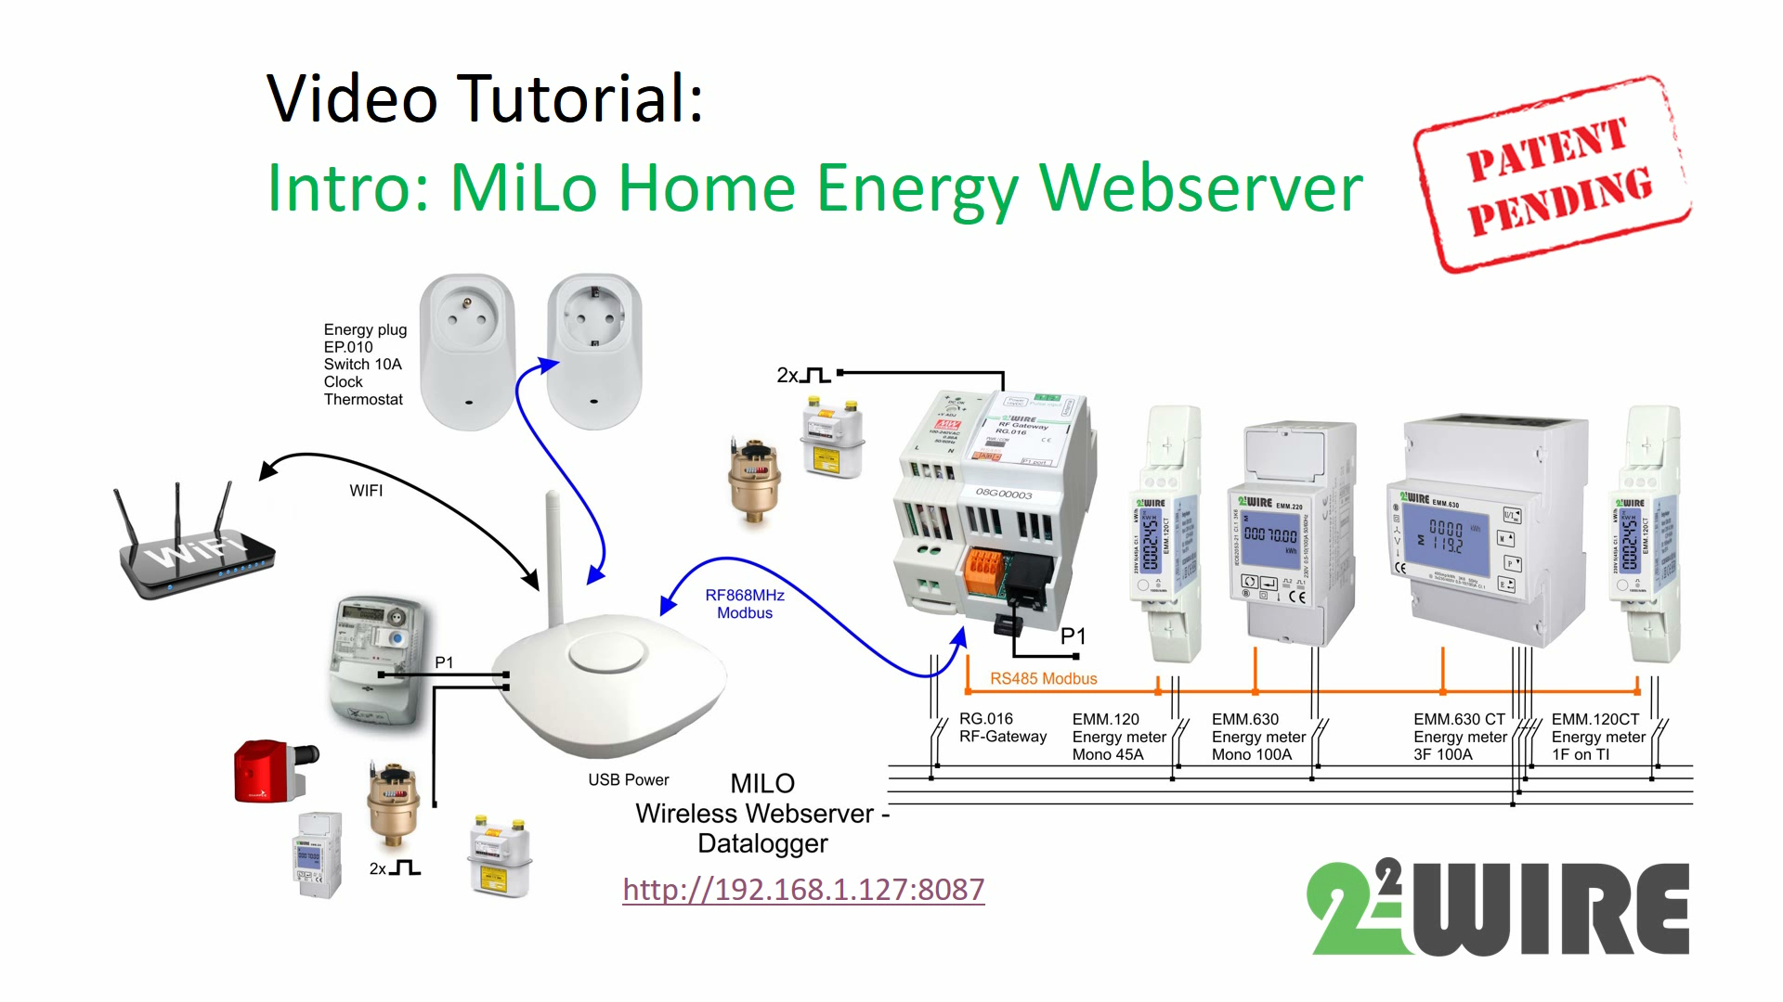

Slide 19
L. FAQ
Do I need to install software or an app on my Phone or tablet?
No software is needed, you can use the bowser on your favourite device to go to the “responsive” webpage in the MEMo or MiLo server.
What do I need if I want to install this at home?
You need or a Milo server or a MEMo server or both + some additional meters to measure suspected appliances: energy plug, pulse counter, Modbus meter, heat meter, water meter, air quality meter,…
What do I need to measure first?
At least all totals need to be measured ( Total electricity, total gas, total water,…) + some consumers you suspect of being high spenders
Which modules do I need for this and what does it cost?
Calculator: Once you know which consumers to monitor you can use our calculator to make a bucket list.
Installer: On our website you can find a local installer and if you are an installer, we will like to add you in our list.
Can I install this myself?
If you have at least some IT knowledge you should be able to install both MEMo and MiLo ( autoconfiguration) modules yourself. Once you start adding wired MODbus meters though, it is advised that the electrical installer or the HVAC installer is doing this for you.
Can I have access from a distance?
Both MEMo and MiLo are connected network devices, if you configure “port forwarding” in your internet modem you can have remote access to both MEMo or MiLo.
Consumptions measured with the energy plugs can also be remotely controlled.

Slide 20

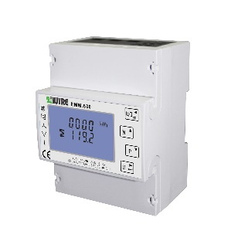
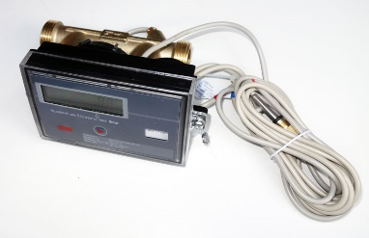
Function: Measure how and what?
Pulse: (MEMo+Milo)
  Water consumption
  Gas and fuel consumption
  Electrical consumption + production
RS485 Modbus (MEMo+Milo):
  Electrical consumption ( MiLo max 3x3F or 9x 1F)
  RS485 Air quality (CO2, RH%,T)
  Temperatures (-15…+85°C)
  RS485 Calorimeters
  RS485 Watervolume meters
RF868 Modbus ( MiLo+MEMo):
  Electrical consumption (plug)
  Thermostat electrical heating (IR panels)
  …
P1 smart meter:(MEMo+Milo)
  Electrical import
  Electrical export (solar)
  Gas consumption

